Slide 1

AI Lecture Generator - An Interactive E-Learning Platform
Presented by:
Anji Reddy Sattaru
Surya Teja Reddy Chitti
Vedanth Reddy Doddannagari
Srikanth Thota
Mounika Aithagoni
Hima Sai Kuruba
Venkata Susmitha Duggineni
This cutting-edge platform uses AI to create dynamic video lessons, packed with quizzes and a live Q&A chatbot, transforming the way you learn at your own pace.

Slide 2

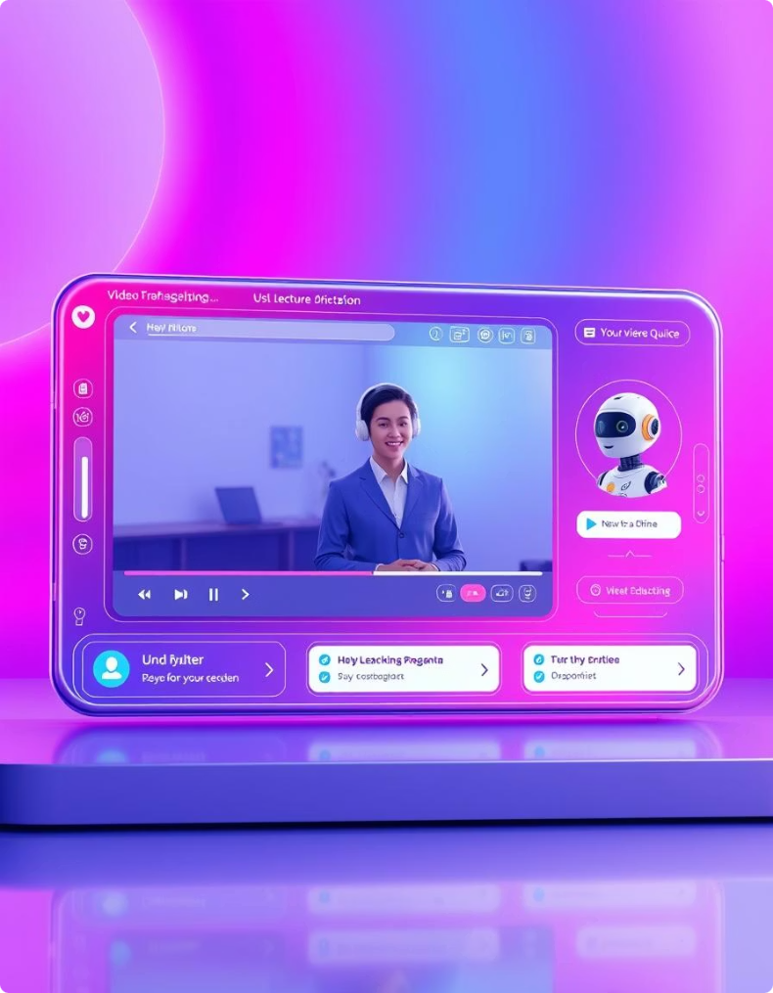
Project Overview and Goals
Automated Content Creation
Engagement Features
A chatbot supports real-time, topic-specific Q&A, enhancing learner interaction. Interactive quizzes provide immediate feedback to reinforce understanding.
Converts user topics into fully structured lectures including agenda and recap sections, streamlining course material generation to save educators’ time.
Multimedia & User Management
Avatar Creation with Echomimic v2
Supports diagrams, code snippets, and math equations. User profiles allow tracking of generated lectures through signup and login functions.
An advanced avatar embedded within videos acts like a professor, dynamically explaining lecture content to provide a personalized and engaging learning experience.

Slide 3
Addressing Key Challenges in E-Learning
Limitations of Current Systems
Our AI-Driven Solution
Pre-recorded videos are static and do not adapt to individual learning pace or questions.
Lecture content dynamically generated to fit input topics and learner needs.
Lack of instant, contextual support for learner queries hinders engagement.
Context-aware chatbot providing instant, accurate answers to learner questions.
Manual quiz creation increases educator workload and delays feedback delivery.
Automated quiz generation seamlessly integrated with lecture content for timely assessment.

Slide 4

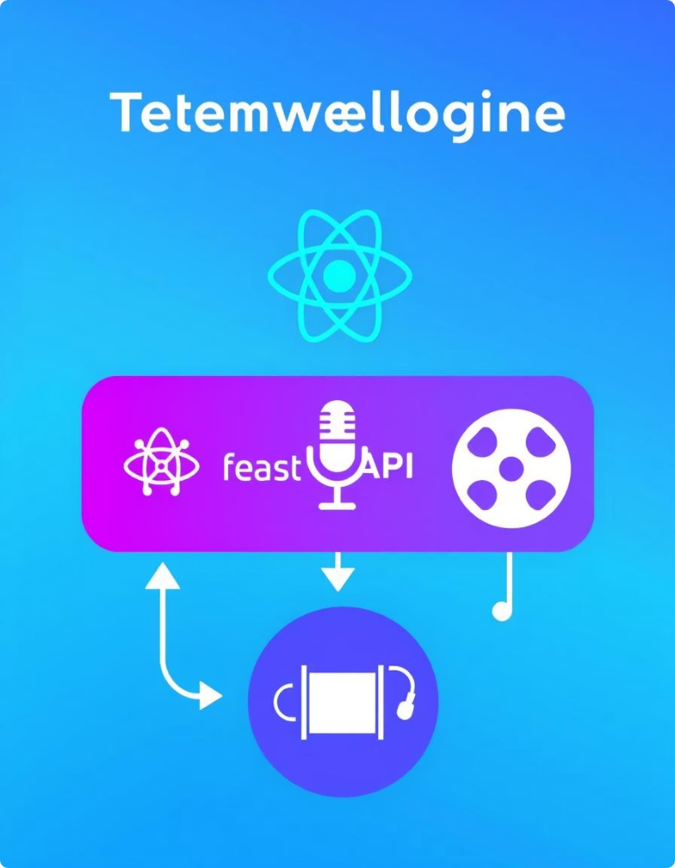




Technology Stack Behind the Platform
Frontend Technologies
Backend Components
React framework featuring Gradio UI for chat interface controls and Playwright for rendering slide visuals.
FastAPI manages video generation endpoints, OpenAI GPT-4 generates lecture and quiz content, with TTS for natural audio narration.
Supporting Tools
Avatar Creation
User profile database for managing video history, MoviePy for processing videos, and Git for version control.
Echomimic v2 avatar technology embedded in videos for dynamic, personalized professor-like explanations enhancing learner engagement.

Slide 5

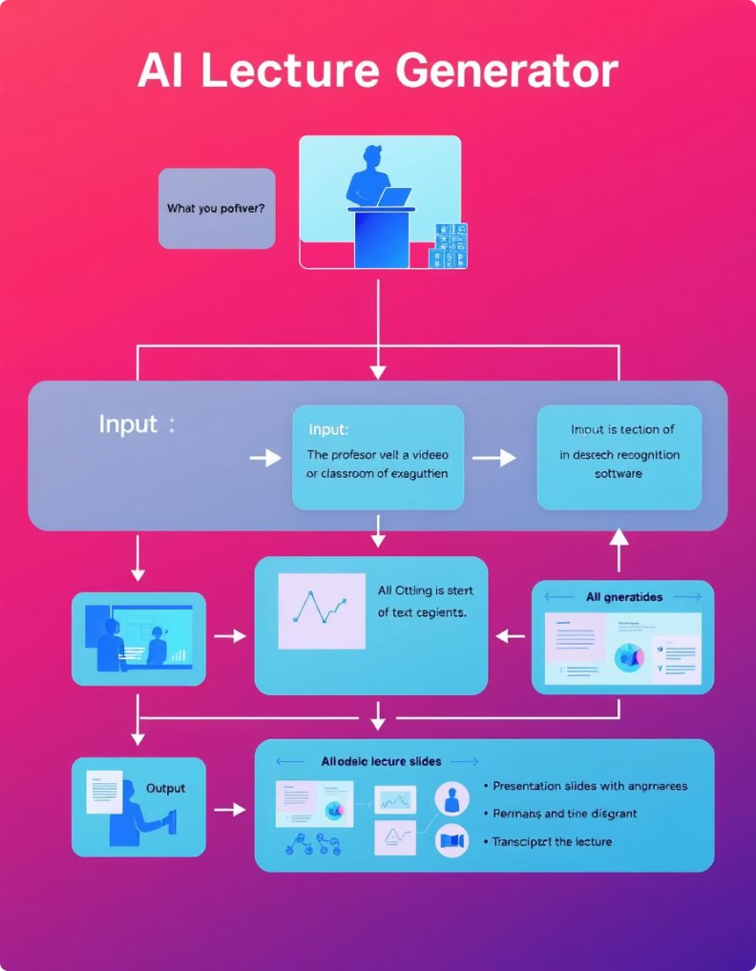
Comprehensive System Architecture
User Input
1
Users submit topics for lecture generation initiating the flow.
2
GPT-4 Generator
Generates lecture content, slides, quizzes, and chat context using AI.
Rendering and Media Processing
3
Reveal.js creates slides, Playwright captures screenshots, and TTS produces audio narrations.
4
Final Assembly
MoviePy merges audio and video into polished lecture videos for playback.
Interactive Modules
5
Quiz interface and chatbot utilize lecture context for seamless learner interaction.

Slide 6

Core Modules and Features
Chat Engine
User Authentication
Video Dashboard
Interactive Quiz Features
Topic-locked GPT-4 chatbot that ensures relevant, on-topic answers relating to the lecture content.
Accessible interface listing all prior lectures, allowing easy review and management.
Enables signup and login to save and track previously generated video lectures for each user.
Automatically generated questions with retry logic providing up to three attempts including tailored feedback.
Avatar Creation
Advanced avatar embedded in videos like a professor, dynamically explaining lecture content to provide engaging learning experiences.

Slide 7

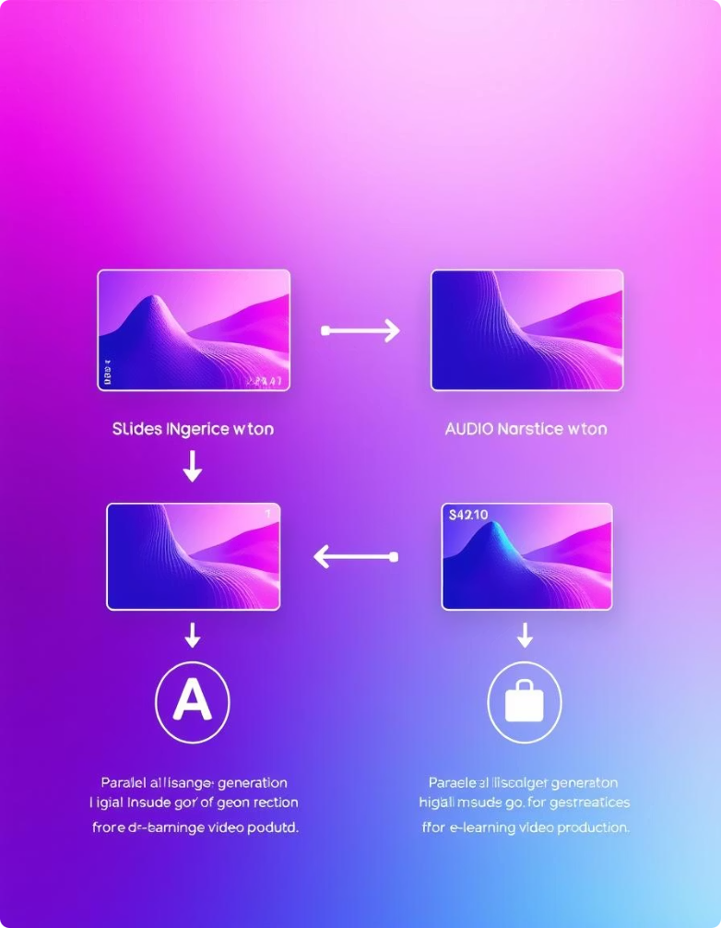



End-to-End Workflow with Real-Time Interaction
Topic Submission
User enters lecture topic triggering AI generation of HTML slides, narration data, and quiz questions.
Parallel Rendering
Playwright generates slide images simultaneously as text-to-speech produces audio clips.
User Access
Lectures delivered with video player plus chatbot and quiz tabs for seamless, interactive learning.

Slide 8
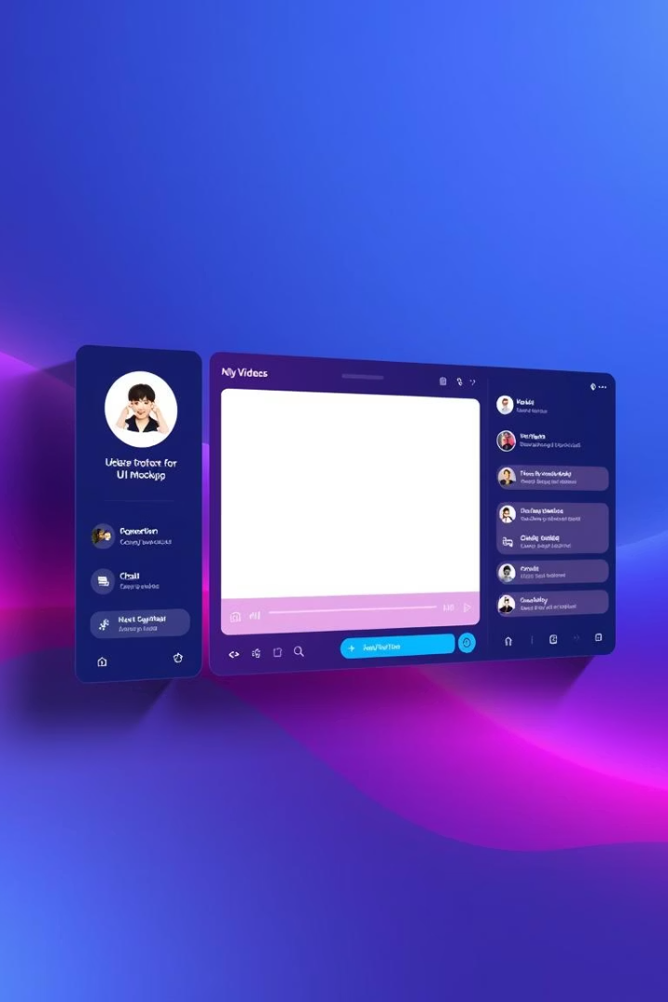
User Interface and Experience Highlights
Chat Interface
Video Dashboard
Simple textbox with system prompt “Chat ready - ask questions!” encourages real-time learner engagement.
Displays thumbnails and titles allowing easy navigation through previously created lectures.
Quiz User Interface
Interactive radio buttons with immediate visual feedback (“🟢 Correct” or “🔴 Incorrect”) boost learner motivation.

Slide 9




Challenges and Solutions in Development
Preventing Off-Topic Responses
Handling Long Code Blocks
Implemented a strict system prompt ensuring the chatbot answers only within the lecture topic context.
Playwright auto-scrolls slides and adjusts font size dynamically for clear rendering of lengthy code snippets.
Avatar Generation Resource Demands
Generating advanced avatars requires GPU-intensive processing, posing challenges for deployment and scaling.
Optimizations and resource management strategies were implemented to address GPU usage effectively.

Slide 10
Scaling the Application for Different User Loads
Scenario 1: Moderate User Base
Scenario 2: High User Base
Supports up to 100 concurrent users with efficient resource use.
Designed for 1000+ users with low latency and high availability.
React frontend hosted on AWS Amplify or S3 + CloudFront
Global frontend distribution on AWS CloudFront
Backend on AWS Elastic Beanstalk or ECS with auto-scaling
Kubernetes deployment with horizontal pod autoscaling (AWS EKS)
Video processing via AWS Batch or EC2 GPU spot instances
GPU-optimized EC2 instances for video rendering
Storage and delivery using Amazon S3 and CloudFront
Multi-region deployment with event-driven task management
Cost Estimation: 10-Minute Video (OpenAI GPT-4o + TTS)
Task
Tokens/Chars
Estimated Cost
Slide + Narration Generation
~4000 tokens
$0.04
Slide HTML Formatting
~1000 tokens
$0.01
Narration Audio (TTS)
~9000 chars
$0.135
Quiz + Chatbot
~2000 tokens
$0.02
Total (approx.)
$0.21

Slide 11

Deployment on AWS EC2
We successfully deployed the application on AWS EC2 instances for scalable performance.
This setup provides flexible resource management and easy integration with other AWS services.

Slide 12



Thank You. Any Questions?
Engage
Connect
Next Steps
We welcome your feedback and questions to improve the platform.
Reach out anytime for support or further discussion.
Explore the platform and experience interactive e-learning firsthand.

